Slide 1

Black Box Test Design Techniques

Slide 2

Agenda
Overview of Blackbox techniques
Use Case table
Error guessing
Exploratory testing

Slide 3
Overview of Black Box testing
What is Black box Testing?
Black-box testing is a method of software testing that examines the functionality of an application based on the specifications. It is also known as Specifications based testing. Independent Testing Team usually performs this type of testing during the software testing life cycle.
This method of test can be applied to each level of software testing such as unit, integration, system and acceptance testing

Slide 4
Behavioural Testing Techniques
Use case table |  | Use case tables are a structured format for documenting use cases in text form. They can be a very simple list of basic information about use cases or contain more detailed information.
Error guessing |  | Error Guessing is a Software Testing technique on guessing the error which can prevail in the code. It is an experience-based testing technique where the Test Analyst uses his/her experience to guess the problematic areas of the application
Exploratory testing |  | Exploratory testing means the testing of software without any specific plans or schedules. This is a formal testing process where we don’t have any test cases or test planning documents to test the application

Slide 5
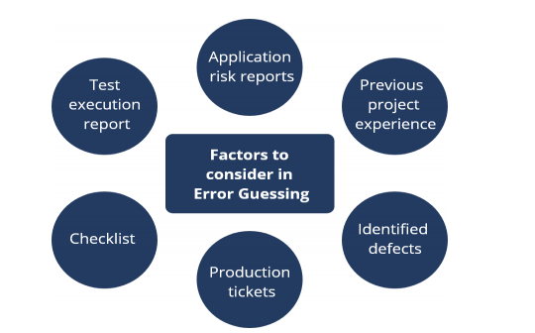
Error Guessing

Slide 6
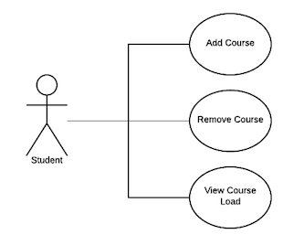
Example for Use case testing

Slide 7
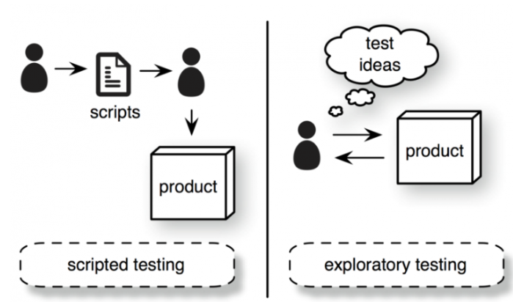
Exploratory testing

